Slide 1

PRESENTATIONS
Complete course
Notes:
Prior to starting this lesson, ensure that you have established ground rules for interaction and psychological safety. Pupils should feel that the classroom is a safe space, that they are not expected to know anything, and are free to participate or pass on discussions.
It is important to have a baseline idea of your students’ exposure to this content. We recommend doing a pre-test with the following questions:
* Have you viewed sexual or sexualized content online – either accidentally or on purpose?
* Do you know what pornography is, and have you seen it?
* Are you or young people you know exploring dating and relationships?
IMPORTANT NOTE: This Powerpoint presentation was set up using the Open Sans font. You should check you have this font on the computer you will be using to show the slides or they may not appear properly. Open Sans is readily available online, and it is free to download and use. Just type "open sans font download" into a search engine and follow instructions on how to install them on your system.

Slide 2
Part 1: What is sexual content online?
Notes:
Prior to starting this lesson, ensure that you have established ground rules for interaction and psychological safety. Pupils should feel that the classroom is a safe space, that they are not expected to know anything, and are free to participate or pass on discussions.
It is important to have a baseline idea of your students’ exposure to this content. We recommend doing a pre-test with the following questions:
* Have you viewed sexual or sexualized content online – either accidentally or on purpose?
* Do you know what pornography is, and have you seen it?
* Are you or young people you know exploring dating and relationships?
IMPORTANT NOTE: This Powerpoint presentation was set up using the Open Sans font. You should check you have this font on the computer you will be using to show the slides or they may not appear properly. Open Sans is readily available online, and it is free to download and use. Just type "open sans font download" into a search engine and follow instructions on how to install them on your system.

Slide 3
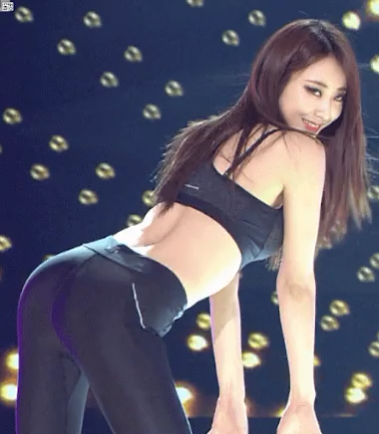
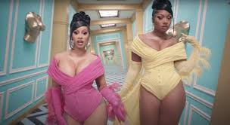
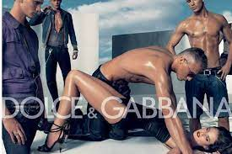
Look at the pictures,
what do they have
in common?
1
Notes:
Teacher asks the question as pupils settle down for the lesson. Use random questioning to select pupils’ answers.
Listen for answers such as:
* They are all sexy
* There is lots of exposed skin/body showing
* They are from ads/music videos

Slide 4
Learning
outcomes
By the end of this lesson, students will have:
Defined “sexual content”
Identified sexual and sexualized content online and discussed the difference between the two
Explored and discussed the areas where young people may potentially encounter sexual content online
2
Notes:
By the end of this lesson, students will have:
Defined “sexual content”
Identified sexual and sexualized content online and discussed the difference between the two
Explored and discussed the areas where young people may potentially encounter sexual content online

Slide 5

What is
sexual content?
Put a tick next to the items you think could contain sexual content.
3
Notes:
Write the following list on the white board or on a flip chart:
Sexting
Celebrity nudes
Documentaries
Plastic surgery
Sending nude pics
Dating apps
Sexually explicit language
Pornos
Video games
Photoshopped pictures
Chat forums
Facebook groups
Photo and Video sharing apps (Instagram, Snap Chat, TikTok, etc.)
Have students come up and put a tick mark next to items that could contain sexual content. Alternately you can drive a discussion around this list and check off items as a group.
If students offer up other items that could contain sexual content, add them to the list and discuss.
The takeaway is that any/all of these on the list could contain sexual content.

Slide 6
Sexual content is…
any content that makes someone
sexually aware
4
Notes:
Debrief the previous slide by landing the point that sexual content is ANY content that makes someone sexually aware.
Explain that there is a difference between sexual content and sexualised content - and that the line can be blurry. Social media sites like Facebook, TikTok, and Instagram have community guidelines and definitions of what is appropriate, however content often needs to be individually reviewed.

Slide 7
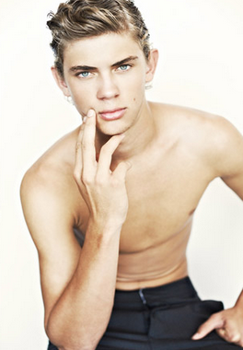
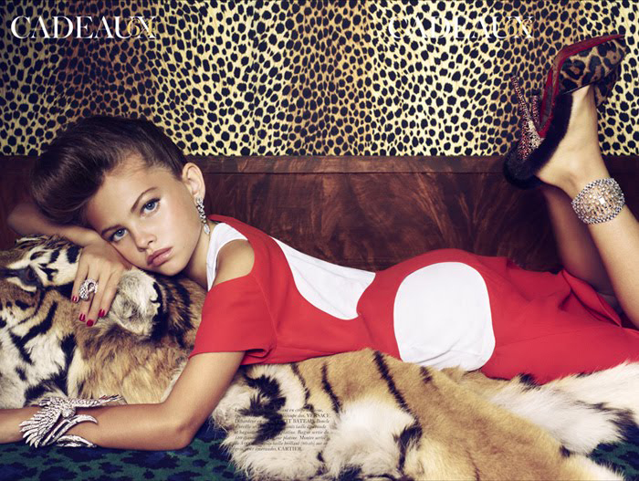
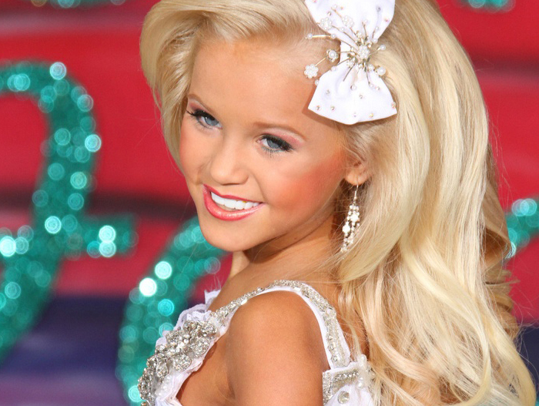
What is
sexualised content?
5
Notes:
Sexualised content is an image or images that were deliberately made to look sexual – and can include over sexualised images of children. This content can often just walk the line of appropriateness.
Ask students what contributes to an image looking sexualized. Listen for: Clothes, pose, makeup, hairstyle, expression, etc.
Ask the group what they think the impact of these sorts of image is. Listen for:
Young people think they are expected to look like this
Forms a first impression of what is considered attractive or alluring
Can make young people feel they need to grow up fast or act more mature

Slide 8

Where might young people
find sexual content
online?
Write down where one might find sexual content online. Consider the differences between sexual and sexualized content. When you’ ve finished, peg it onto the ‘washing line of communication’
6
Notes:
Provide post it notes to all students. Ask them to write down places where young people might encounter sexual content online and post on the white board. Take note of and discuss the list that is posted on the board.
Alternately, have students raise their hands if they have seen sexualized content in:
Music videos
Advertisements
Magazines
Streaming shows
Movies
Social Media sites (ex: clicking the wrong link on youtube)
Pop up ads while gaming
Porn sites
Anywhere else?
Be sure to include discussion not only of types of websites and forums where young people might find sexual content, but also that it is readily accessible on many devices – smartphones, tablets, computers, etc.

Slide 9
Have your
say!
Using the double bubble map, evaluate the impact of sexual content online and highlight the differences and similarities between sexual and sexualised content
7
Notes:
This is an open task where teachers allow time for pupils to evaluate sexual content. Explain that you will be creating a double bubble map in pairs to explore the differences between sexual and sexualized content.
Encourage the students to consider the differences between sexual and sexualised content and consider them in relation to the risk they pose and the impact they have on their feelings or behaviors.

Slide 10
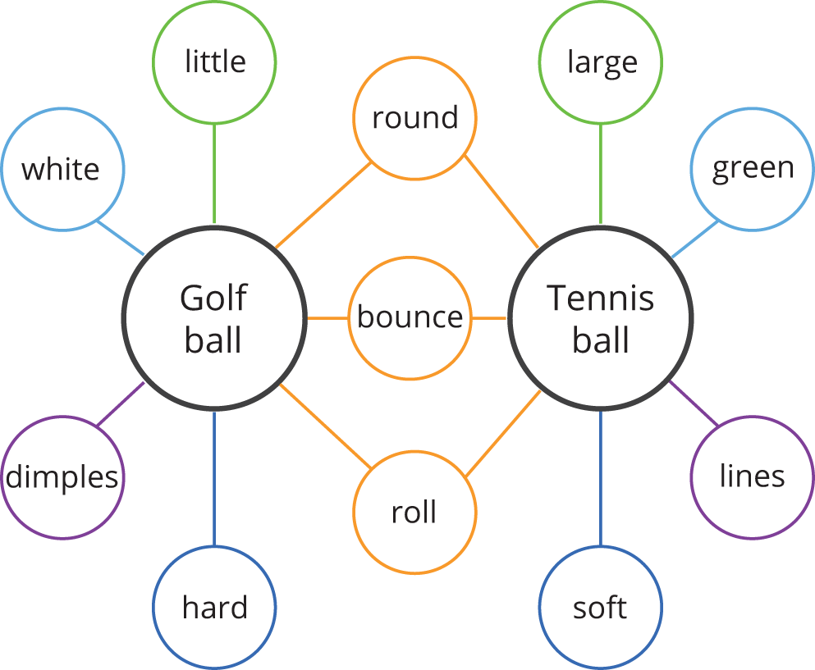
Double bubble example
8
Notes:
Draw a blank double bubble diagram on the wall, with Sexual written in one bubble, and Sexualised written in the other. Provide post it notes for all pupils to write on – so they can reposition the notes as the discussion progresses. Once the groups have organized sexual vs. sexualised content into categories around the two bubbles – review their map, and acknowledge the themes you see emerging.
To support lower ability students, a Post-it could have some choices or a list for students to prioritize, most sexual to least sexual content.

Slide 11

Tweet one thing you have learnt from this lesson
Tweet anything in the lessons that has surprised you
Finally, tweet anything you would like more information about
#AtFirstSite
9
Notes:
Work together with pupils as a group to draft tweets of what they feel was the most important thing they have learnt from this lesson, what surprised them, and what they want to learn more about.
Teacher should post the tweets using the hashtag AtFirstSite.
Do NOT have the pupils tweet this themselves.

Slide 12
End of Part 1

Slide 13
Part 2: The media and body image
Notes:
Prior to starting this lesson, ensure that you have established ground rules for interaction and psychological safety – and remind students that you have done this. Pupils should feel that the classroom is a safe space, that they are not expected to know anything, and are free to participate or pass on discussions.
It is important to have a baseline idea of your students exposure to this content. We recommend doing a pre-test with the following questions:
* Have you viewed sexual or sexualized content online – either accidentally or on purpose?
* Do you know what pornography is, and have you seen it?
* Are you or young people you know exploring dating and relationships?
IMPORTANT NOTE: This Powerpoint presentation was set up using the Open Sans font. You should check you have this font on the computer you will be using to show the slides or they may not appear properly. Open Sans is readily available online, and it is free to download and use. Just type "open sans font download" into a search engine and follow instructions on how to install them on your system.

Slide 14
sex?
It’s all about
Think of as many adverts as possible that use sexual content to sell products
Notes:
In groups get the students to brainstorm where they see sexual / sexualized content in adverts

Slide 15
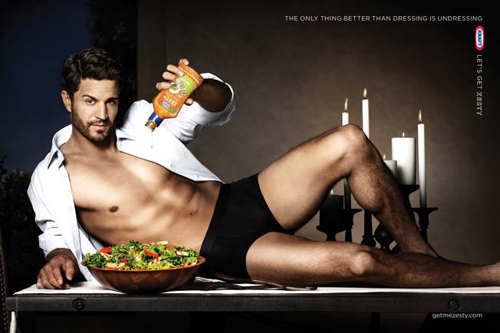

How do companies
use sexualised images
in their adverts?
Kraft
Budweiser
© IFFOR
Notes:
Encourage them to debate the role of sexual content in adverts – especially how they encourage extreme versions of femininity and masculinity – and can be exclusionary towards any other gender representations. Have they seen this change at all in recent years? How have social media platforms like Instagram and tik tok enabled people to expand how they are portrayed in advertising?
Have students stand on one side of the room if they think the way people are portrayed in advertising influences how young people see themselves and the people in their lives. Have students stand on the other side of the room if they don’t think ads influence this.
Ask questions to draw out why they chose one side over another: eg What made them choose that side of the room? What do they see in the world that supports this belief? Recognize that both viewpoints are, of course, true. Some people are more susceptible to being influenced than others, and many factors, such as their role models, what they value, etc. come into play.

Slide 16
Learning
outcomes
By the end of this lesson, you will have:
Discussed how the media influences public opinion about body image, and impacts young people
Reviewed different ways that bodies are represented and used in the media
Explored ways to push back against idealised and unrealistic body representations
3
Notes:
Review the learning outcomes for this lesson, and what students can expect to take away.

Slide 17

What do you think
body image is?
Discuss with a partner to come up with a deﬁnition.
Be ready to share.
© IFFOR
Notes:
On their worksheets get them to write their definition of body image
Draw out things like:
- Is it their own definition (what they see)
- What others see?
- How do they define it?
- Is it a positive or a negative thing and how does it affect how a young person sees themselves?
Here is one definition of body image taken from Wikipedia:
“Body image is a person's perception of the aesthetics or sexual attractiveness of their own body. It involves how a person sees themselves, compared to the standards that have been set by society.” Wikipedia

Slide 18
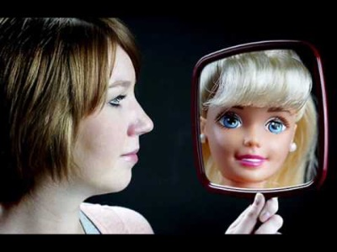
We constantly see striking images online that can make exceptional good looks seem commonplace
© IFFOR
Notes:
Show the video – and gather some reactions.
Video: https://www.youtube.com/watch?v=31Ajvix6DXs

Slide 19
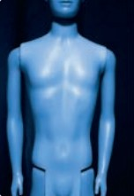
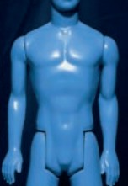
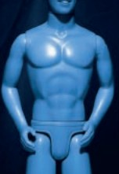
How has the view of
over the years?
body image changed
1960s
1970-80s
90s-2000s
Notes:
The image shows changes made to the same action figure over time.
Discuss the fact that body image is highly subjective and changes with time and fashions. Are any of these an ideal body? Or is the way we look aﬀected by societies expectations?

Slide 20
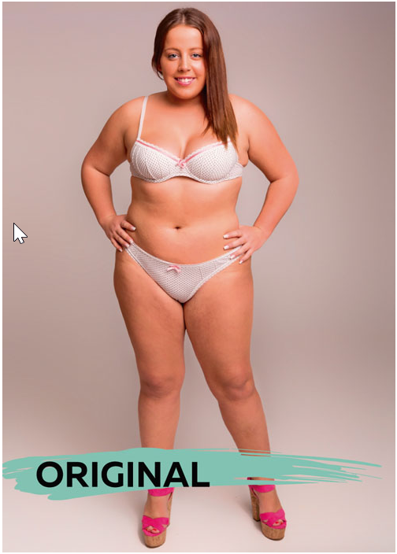
Does culture impact
body image ?
THE TASK:
“Photoshop this woman to make her more attractive to the citizens of your country…”
Notes:
In 2015, journalist Esther Hoenig commissioned a group of designers from around the world to do one task: “Photoshop her form. The idea is to Photoshop and retouch this woman to make her more attractive to the citizens of your country. We are looking to explore how perceptions of beauty change across the world. Multiple designers are involved. You can modify clothing, but her form must be visible. No nudity. All other changes, including those to her shape and form, are up to you.”
The goal of this project was to better understand potentially unrealistic standards of beauty and to see how such pressures vary around the world.
Sourced from: https://petapixel.com/2015/08/15/one-woman-photoshopped-by-18-countries-beauty-standards-revealed/

Slide 21
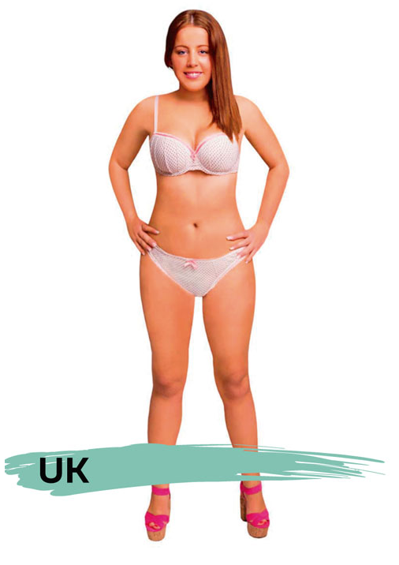
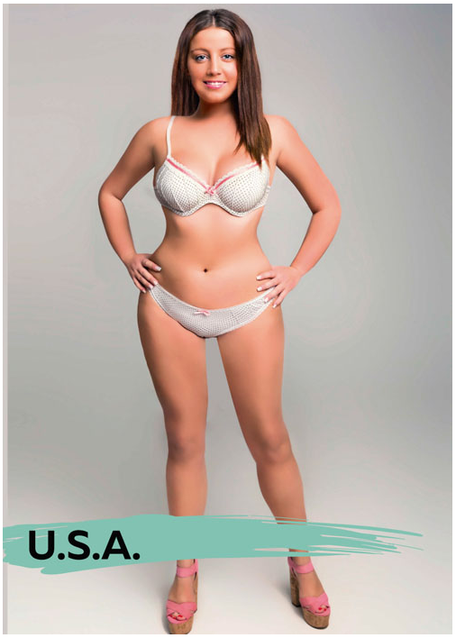
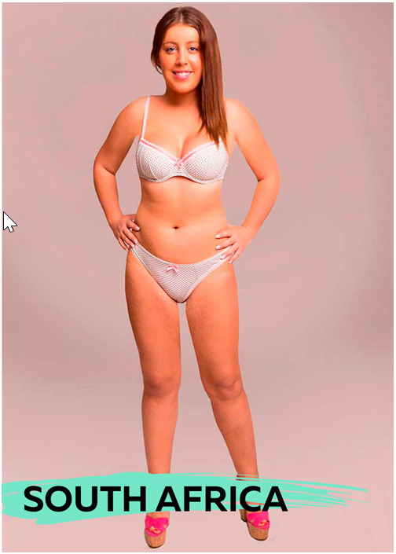
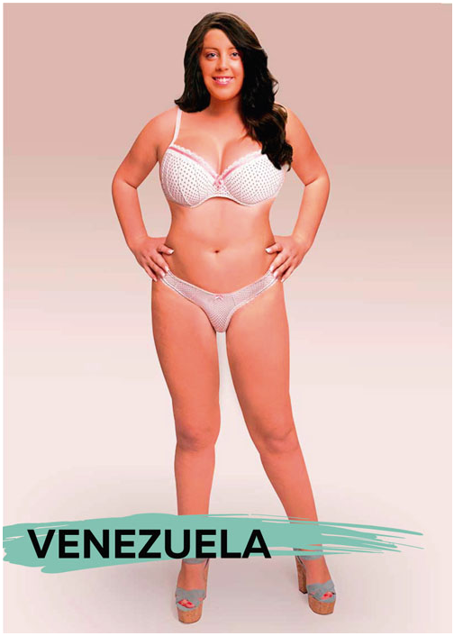
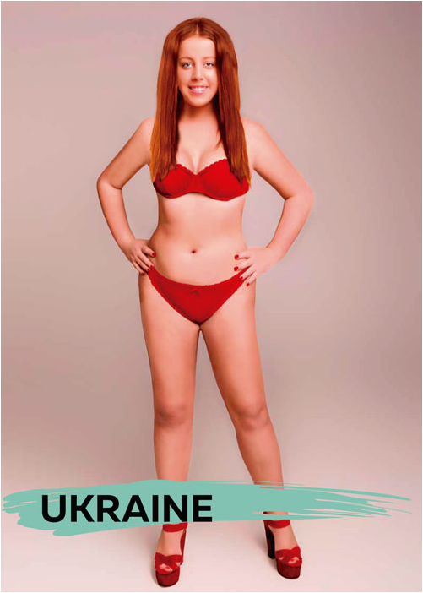
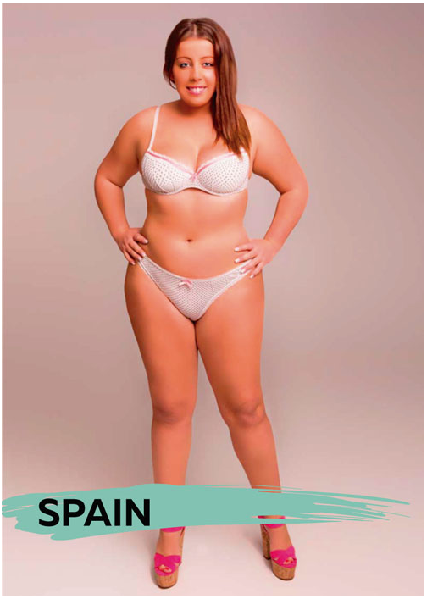
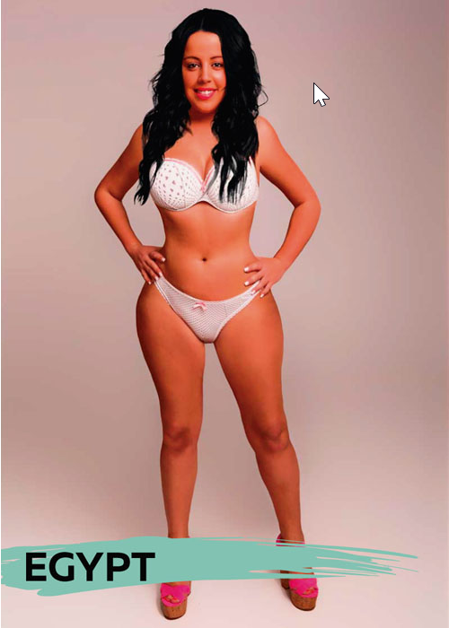
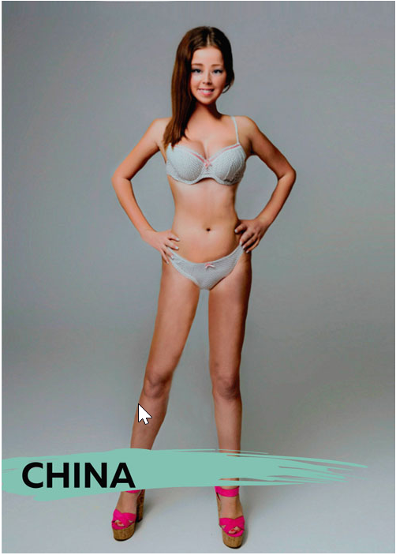
Notes:
The experiment found that…
Some of the designers kept the woman largely looking like herself, while others made her look like a new person altogether.
Some countries gave her an exaggerated hourglass figure, while others gave her an apparent BMI of 17.5, or near anorexic.
China and Italy returned the thinnest Photoshopped figures (China’s had an estimated BMI of 17), while Spain returned the heaviest.
“Beauty cannot be judged objectively, for what one person finds beautiful or admirable may not appeal to another,” the experiment concludes. “And the range of depictions found in our study appears to confirm this notion.”
Ask students what they notice. Point out that Spain barely changed the original at all, where China’s changes were drastic.

Slide 22
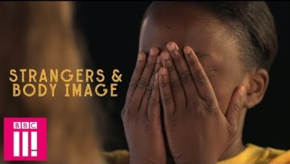
What happens when strangers get real…
© IFFOR
Notes:
What Happens When Strangers Get Real About Body Image: https://www.youtube.com/watch?v=xBEpOOlhNVQ
Show the video – and then run the following debrief.
What did you take away from that video? What can we learn from this?

Slide 23
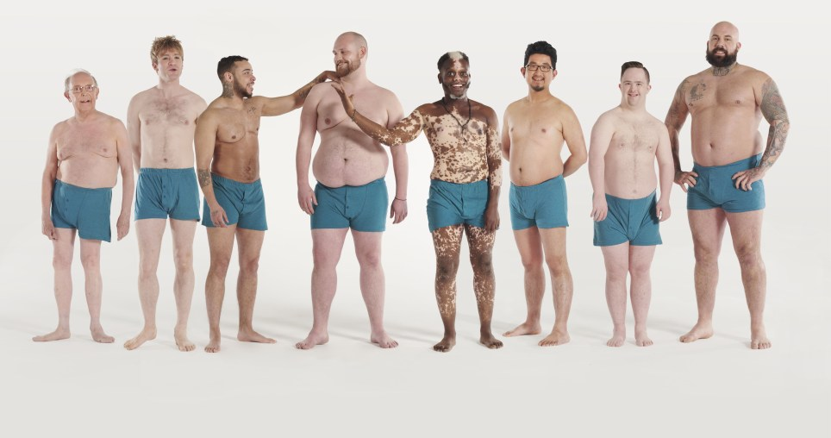
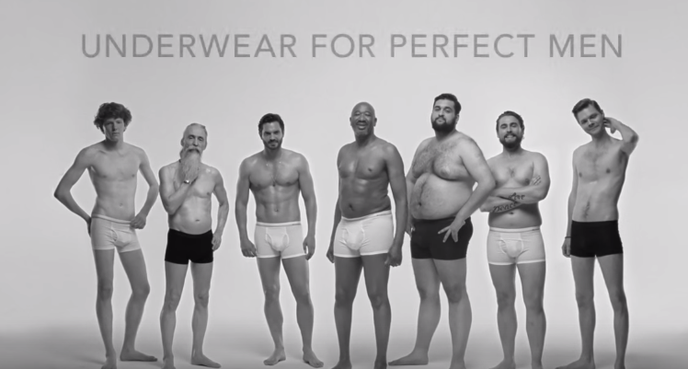

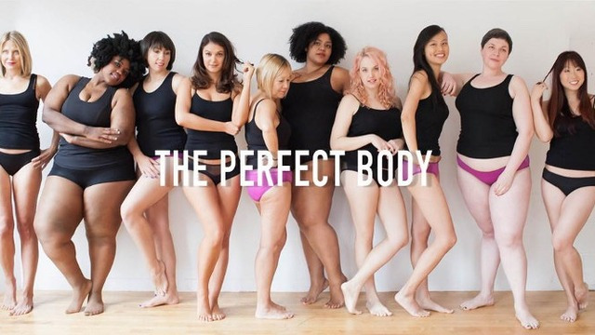
Get real
Notes:
In recent years, there has been a pushback from the public and even socially conscious advertisers to help combat the unrealistic images that have dominated our media for so long.
Have a look at these photos. How do you think seeing more images like this could help young people with accepting their own bodies?
Images:
Top left: https://metro.co.uk/2019/05/13/men-of-manual-campaign-challenges-male-body-image-in-the-media-9506564/
Top right: https://metro.co.uk/2015/10/17/new-underwear-ad-wants-to-welcome-men-into-the-body-positive-movement-5445567/
Bottom left: https://medium.com/@ashleybroadwater346/how-to-be-body-positive-without-being-ableist-cdebceb34b59
Bottom right: https://hometruthsco.wordpress.com/2018/04/09/the-significance-of-the-body-positive-movement-on-instagram/

Slide 24

positivity!
Share the
You have until the music stops to move around the room, and find one person to compliment.
We will run 3 rounds – so think about what you would say!
© IFFOR
Notes:
Run three rounds of the following exercise:
Play music while you have all students mill about the room. When the music stops, they need to find the person nearest to them, and tell them something positive that they notice about them.
Do this three times. Debrief by asking students how that felt? How did it feel to give the compliment? How did it feel to receive the compliment? Was that exercise easy or hard?
End with this point – we can just as easily lift ourselves up as we can criticise. It’s just depends on your habits of mind. Imagine what life would be like for young people if they all developed a habit of focusing on the positive aspects of themselves – and on being the best real version of themselves – rather than striving for an unrealistic ideal.
Ask for a show of hands of who would like to live in a world like that. End by encouraging them to practice.

Slide 25

Next steps
12
© IFFOR
Notes:
Bring the activity to a close and reassure the learners that you will be continuing to explore the topic in the next part of the programme.
Consider discussing positive campaigns that exist and their impact.

Slide 26
End of Part 2

Slide 27
Part 3: The media and celebrities
Notes:
Prior to starting this lesson, ensure that you have established ground rules for interaction and psychological safety – and remind students that you have done this. Pupils should feel that the classroom is a safe space, that they are not expected to know anything, and are free to participate or pass on discussions.
It is important to have a baseline idea of your students exposure to this content. We recommend doing a pre-test with the following questions:
* Have you viewed sexual or sexualized content online – either accidentally or on purpose?
* Do you know what pornography is, and have you seen it?
* Are you or young people you know exploring dating and relationships?
IMPORTANT NOTE: This Powerpoint presentation was set up using the Open Sans font. You should check you have this font on the computer you will be using to show the slides or they may not appear properly. Open Sans is readily available online, and it is free to download and use. Just type "open sans font download" into a search engine and follow instructions on how to install them on your system.

Slide 28
The Media and Body image
recap
In the first part of this activity, you explored some of the issues associated with body image:
The ways in which sexualised images are used to market products
The impact on young people of constant images of perfection
The ‘perfect body’ and how it is a changing and unrealistic target
Notes:
Review what they explored in the first part (Part 2) of the lesson

Slide 29
Learning
outcomes
By the end of this lesson, you will have:
Discussed the role of celebrities/influencers on body image
Explored how different celebrities handle the way they are portrayed
Brainstormed different ways young people can tackle the portrayal of unrealistic imagery in the media
2
Notes:
Review learning outcomes and what students should expect to take away from this lesson.
By the end of this lesson, you will have:
Discussed the role of celebrities and influencers in fighting or maintaining unrealistic portrayals in the media
Explored how different celebrities handle the way they are portrayed
Brainstormed different ways that young people can fight against the portrayal of unrealistic and harmful imagery in the media

Slide 30
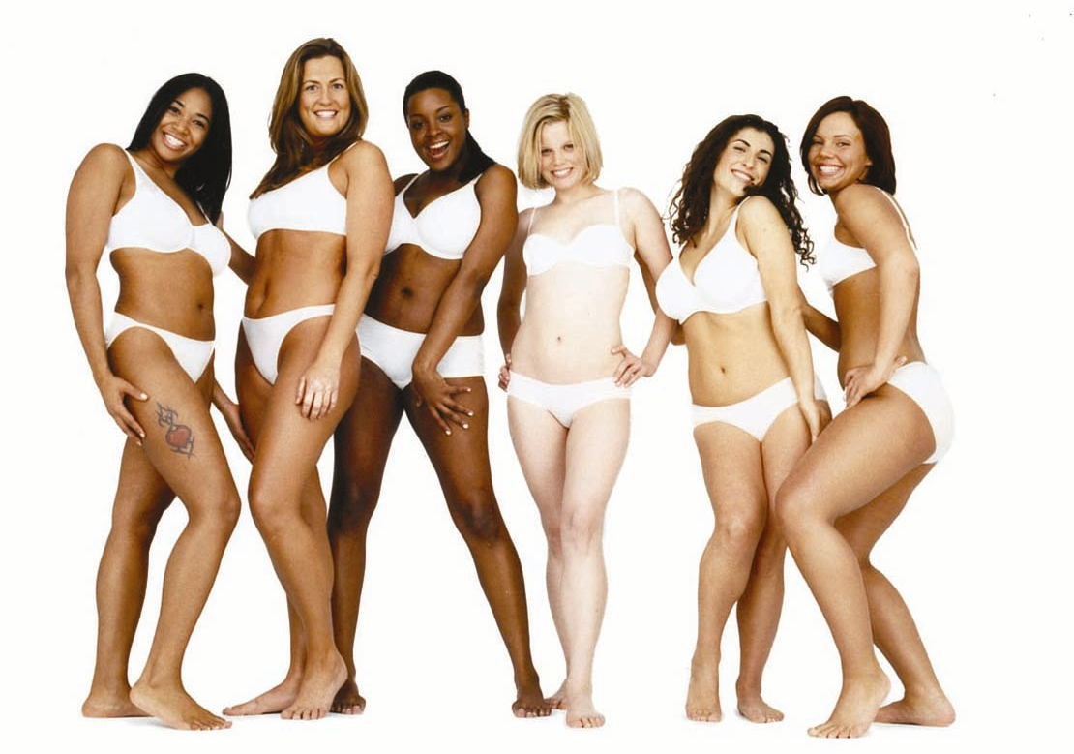
Do we do enough
to celebrate
real beauty?
© IFFOR
Notes:
We ended the last lesson with a brief look at body positivity, and you practiced being more positive with each other. You also saw, however, how strongly society and the images we are bombarded with can undermine our positive mindset. Do we do enough to celebrate real beauty?

Slide 31
these facts?
Are you surprised by
Boys as young as 16 are
turning to steroids to transform themselves into their sporting heroes
There has been a massive increase in websites that cater for eating disorders, providing advice and tips
How did we get here?
© IFFOR
Notes:
Why do you think young people are trying to change their bodies?
Listen for answers like:
To meet expectations of attractiveness
Insecurity
To be more popular with others
They think their problems will be solved if they are more attractive
Etc.

Slide 32
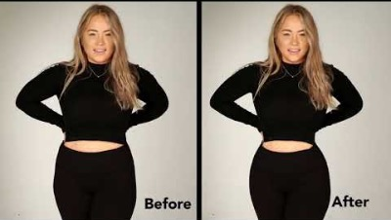
all about?
What is this story
© IFFOR
Notes:
Video: Social Media’s effect on body image: https://www.youtube.com/watch?v=tANI_nlvC90
Show video – and debrief:
What did you take away from that video? What surprised you? What can we learn from this video?
Explore the point that young children are quite happy with their bodies and would only give themselves magical powers. What changes as we get older? (exposure to media)

Slide 33
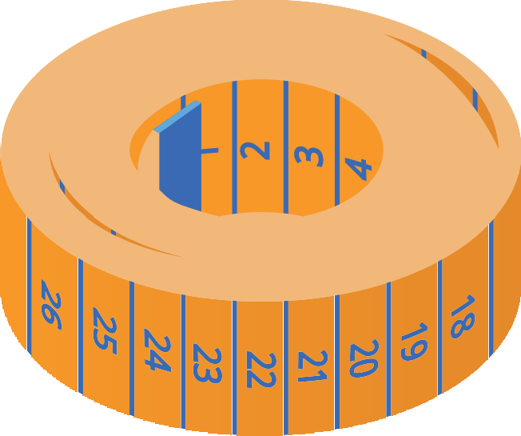

Do you think all celebrities are
really perfect?
Work in pairs to spot as many diﬀerences as you can.
Write down the side of your paper A-E.
You have 30 seconds on each slide.
© IFFOR
Notes:
Give students 30 seconds to examine each slide and write down the differences they notice.

Slide 34
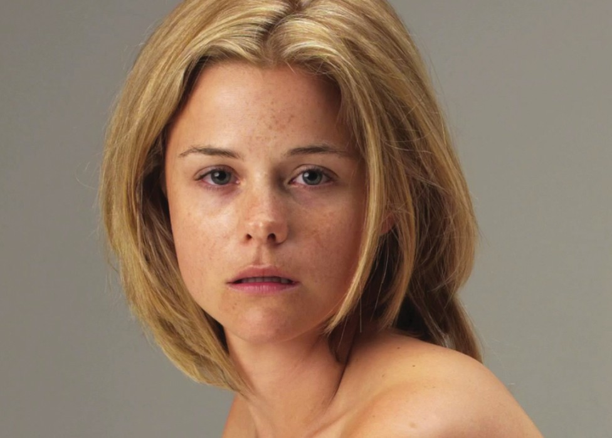
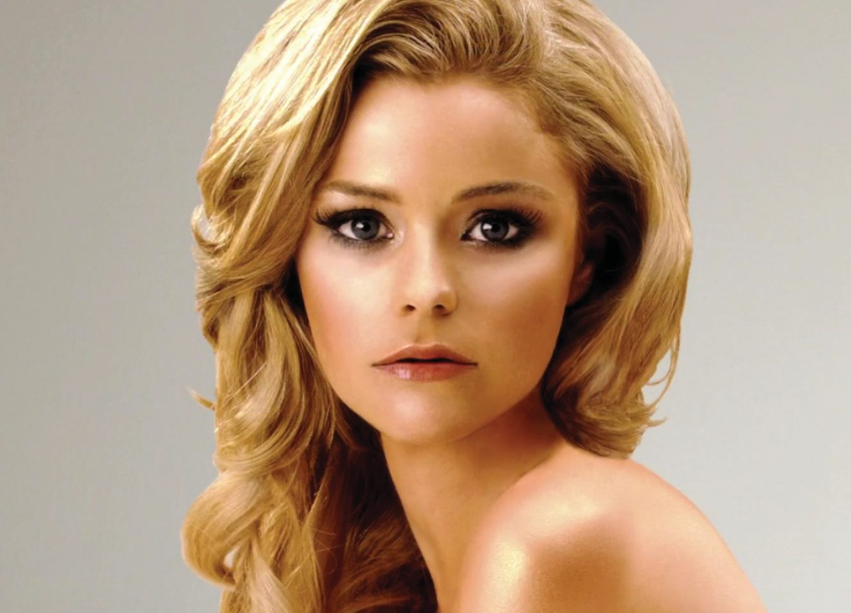
A
© IFFOR

Slide 35
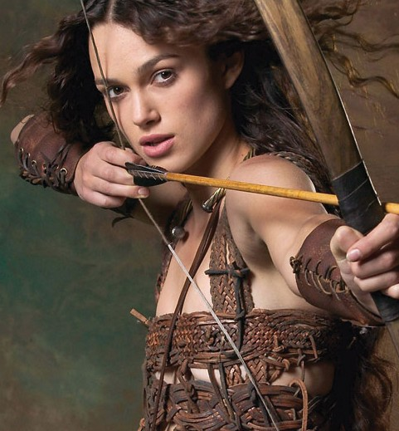
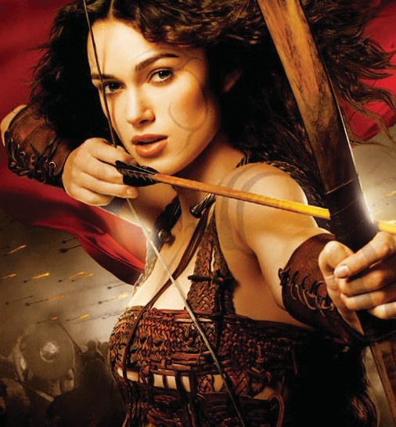
B
© IFFOR

Slide 36
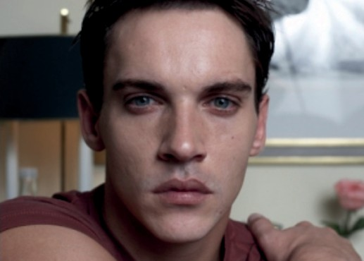
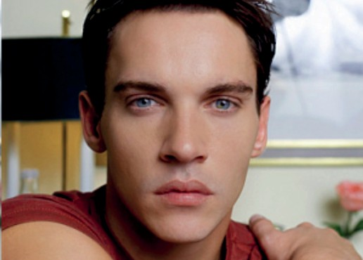
C
© IFFOR

Slide 37


D
10
© IFFOR

Slide 38
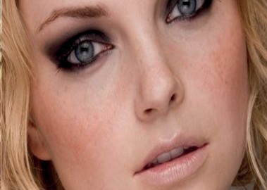

E
© IFFOR

Slide 39
What did you
see?
12
© IFFOR
Notes:
Take a moment to take shares from the students around what they noticed in the pairs of pictures. All the pictures on the left were the originals, and the right were photoshopped. What conclusions can they draw from the before and after pictures?
Consider sharing a story about one of the images: ex: Kiera Knightley being transparent about the fact that they photoshopped much bigger breasts on her body for her movie poster…

Slide 40
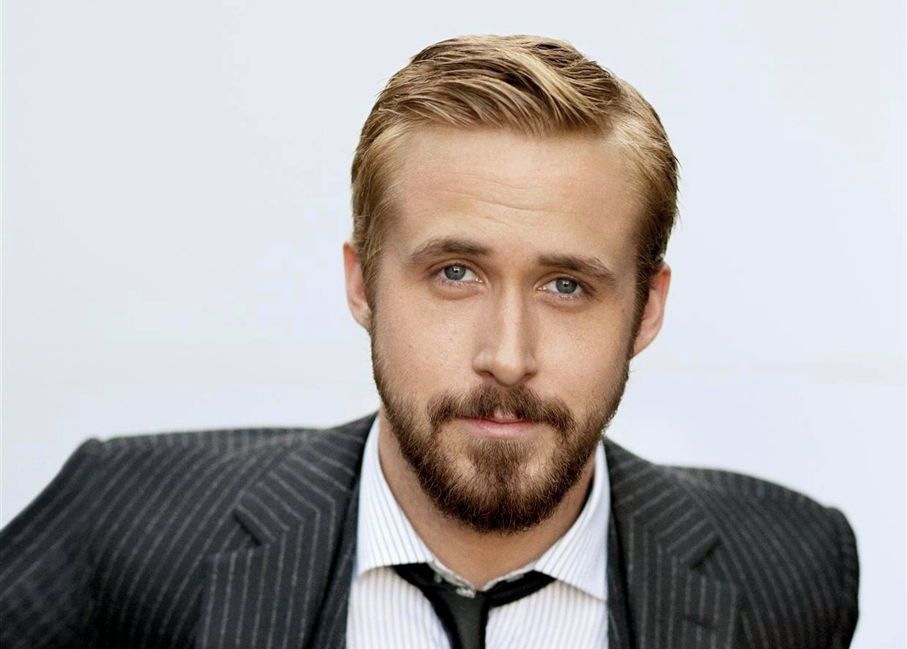
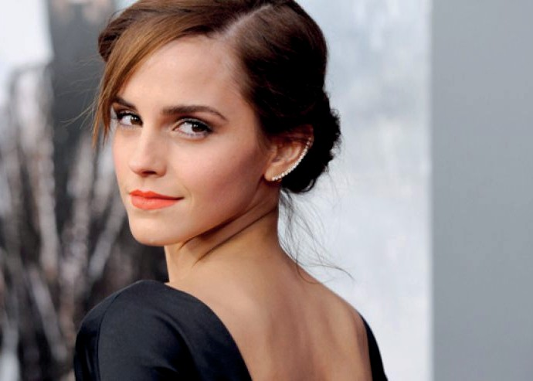
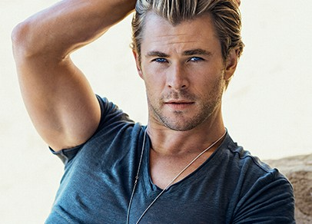
What do you think
goes into making a celebrity
look perfect?
For many celebrities it is their job to look good.
13
© IFFOR
Notes:
Brainstorm what makes celebrities look good.
Get feedback on those thoughts.
Is it realistic to expect yourself to look every day like a celebrity does when they are in front of the camera?

Slide 41

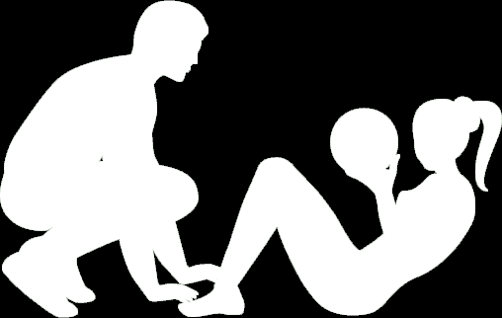


They have:
image consultants
ﬁtness trainers
make-up artists
nutritionists
hairdressers
Is that something most people are willing, or even able, to do?
So…
What can society do to make people feel more comfortable about themselves?
14
© IFFOR
Notes:
Again – is it really possible to look like a celebrity does after tons of work and help from professionals?
Brainstorm ideas to help young people feel more comfortable about themselves. If appropriate, post the list up in your classroom as a reminder.

Slide 42
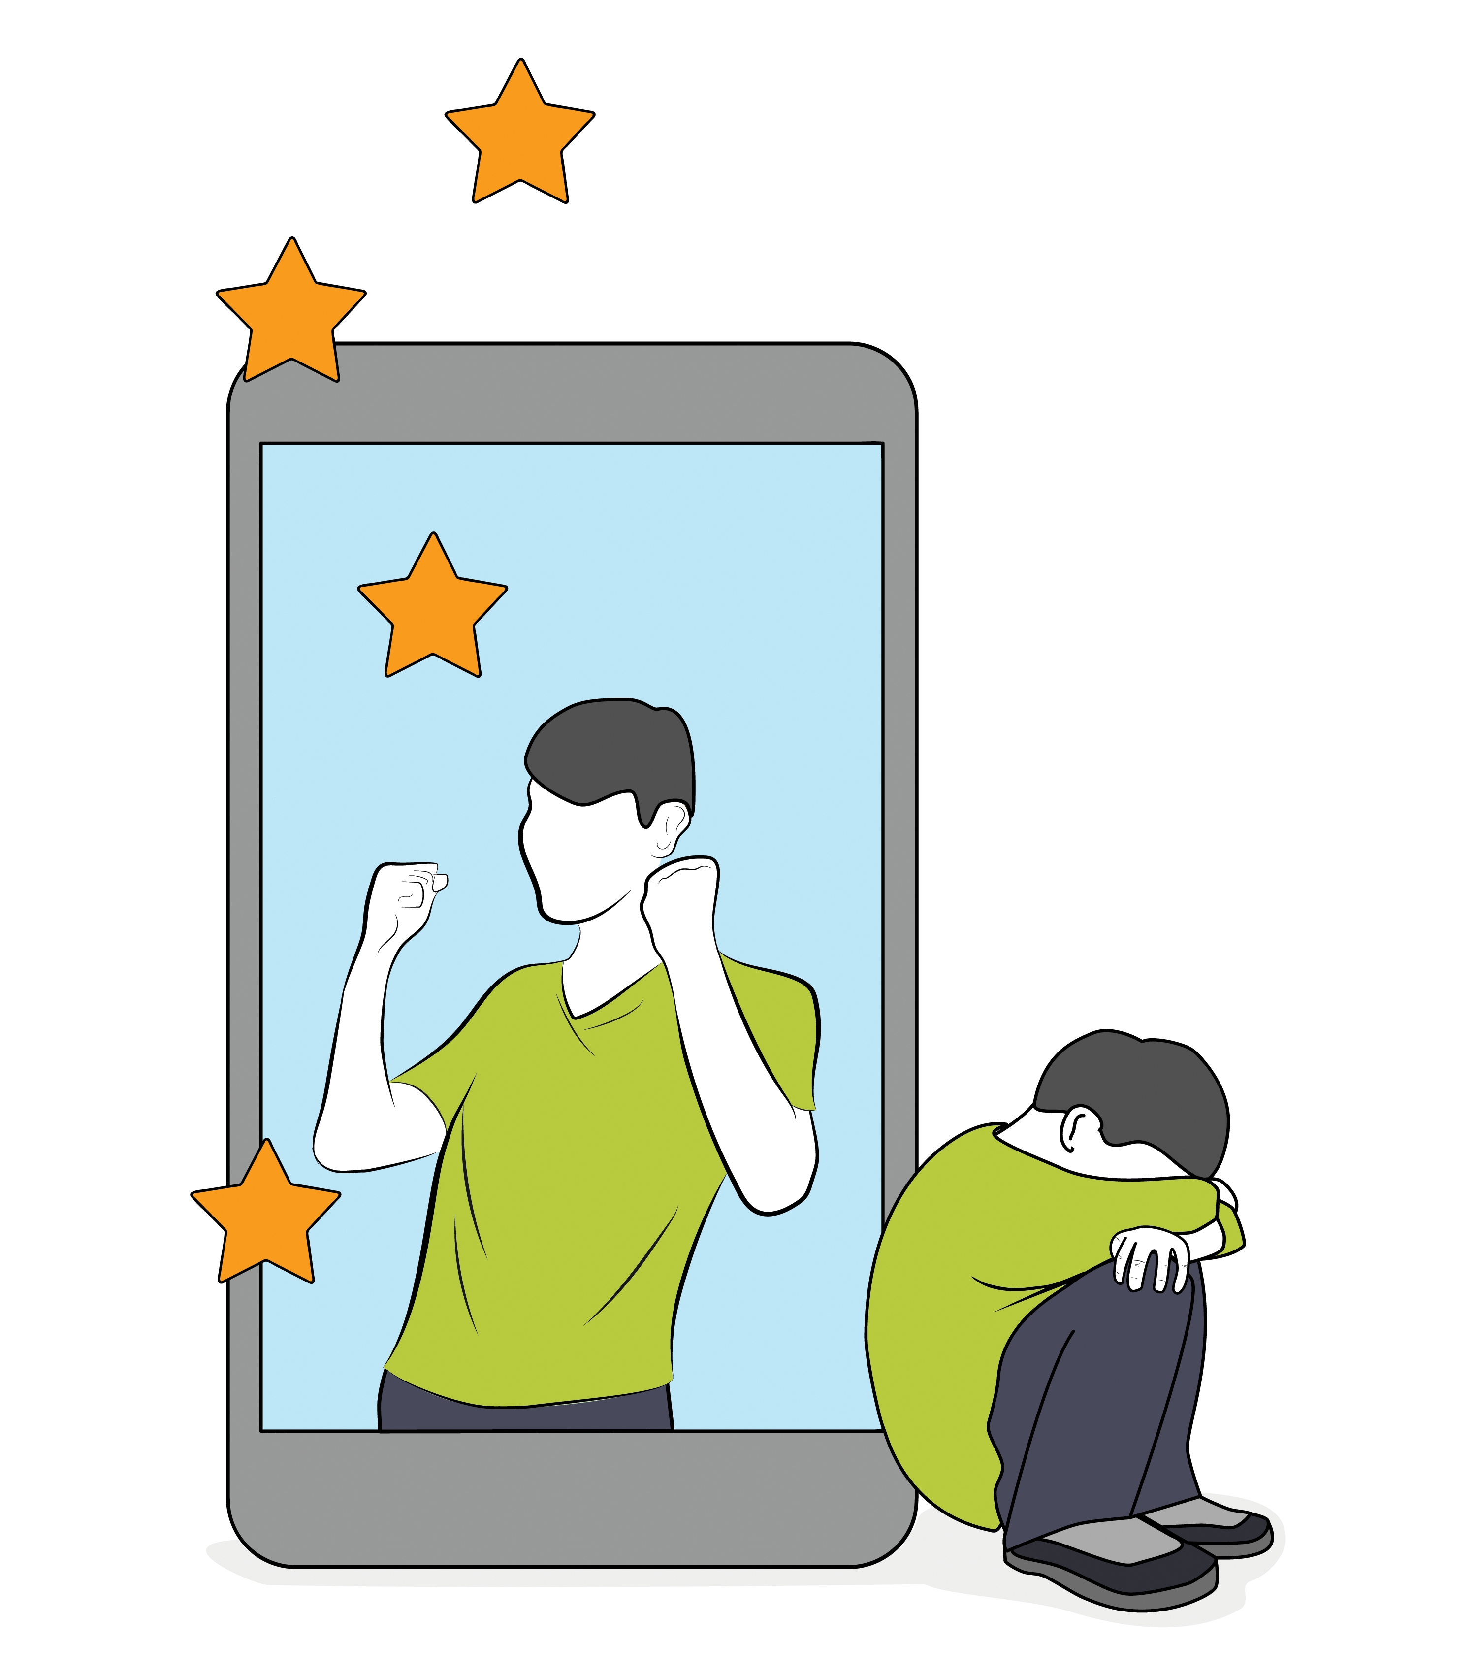
What we see
What we don’t
15
© IFFOR
Notes:
What about the real people on social media? How do you think young people are influenced by those sorts of images?
Conduct a discussion around the following:
When people post on Social Media – are you seeing a representation of their real life, or just what we call the “highlights reel?”
What is the impact of only seeing the best parts of other people’s lives?
What about when a young person posts an image after carefully crafting it and spending lots of time on it? Do you think that feels authentic to them?
What is the risk to young people of their own less authentic posting? (They may be setting up a standard that they themselves can’t live up to. They may feel like a fraud.)
Here are some details focused on Instagram, but which are broadly applicable to all social media (compiled by more-love.org):
Instagram encourages young women to compare themselves against unrealistic versions of reality Royal Society for Public Health: Social media and young people’s mental health and wellbeing
As little as 30 minutes per day on Instagram can make women fixate negatively on their weight and appearance. Macquarie University: Impact of Instagram use in young women
Young women who spend more than 2 hours on Instagram and other social networking sites report poor mental health.
When a teenager’s post gets a lot of “likes” on Instagram, her brain responds in a similar way to seeing loved ones or winning money. [5] UCLA Brain Mapping Center
The more frequently that young women look at #fitspo images, the unhappier they felt about their own bodies

Slide 43

Does the media help
young people have a positive opinion
of their body?
On a Post-it note, suggest one way you could change the way the media aﬀects body image.
16
© IFFOR
This Photo by Unknown Author is licensed under CC BY-NC
Notes:
Provide a post-it note or note paper to each student. Have them write down one way that they could help change the way media affect body image in young people.
Pin up the notes on the washing line or post them on the white board.
Review and commend them on the themes you see and the initiative they are showing.

Slide 44
End of Part 3

Slide 45
Part 4: Fantasy versus reality
Notes:
Prior to starting this lesson, ensure that you have established ground rules for interaction and psychological safety – and remind students that you have done this. Pupils should feel that the classroom is a safe space, that they are not expected to know anything, and are free to participate or pass on discussions.
It is important to have a baseline idea of your students exposure to this content. We recommend doing a pre-test with the following questions:
* Have you viewed sexual or sexualized content online – either accidentally or on purpose?
* Do you know what pornography is, and have you seen it?
* Are you or young people you know exploring dating and relationships?
IMPORTANT NOTE: This Powerpoint presentation was set up using the Open Sans font. You should check you have this font on the computer you will be using to show the slides or they may not appear properly. Open Sans is readily available online, and it is free to download and use. Just type "open sans font download" into a search engine and follow instructions on how to install them on your system.

Slide 46
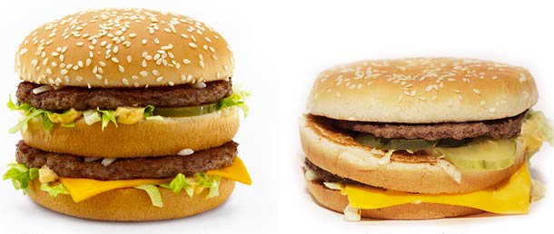
Fantasy versus
reality
Life is like a McDonalds burger…
Your expectations are always better than reality
Notes:
Give a brief introduction to the lesson, explaining that these burgers are an analogy to how sex is portrayed online (in music videos, video games, pornography, etc.) vs. real life. What clues can they see in what the lesson will cover?

Slide 47
Learning
outcomes
By the end of this lesson, you will have:
Discussed the differences between
sex that is portrayed online, and real sex and relationships
Explored the implications of an unrealistic portrayal of sex online
Discussed how to establish healthy views of sex and relationships
2
Notes:
Review learning outcomes with students.

Slide 48

Confidentiality agreement
Respect each others’ views
Listen to each other
Recognise this is a sensitive topic
Agree that the discussions will remain with the room
Highlight (privately) any concerns that you have
© IFFOR

Slide 49

Fantasy vs reality
© IFFOR
Notes:
The terms introduced in this video may not be familiar to all pupils. Teachers should frame this up and explain that although they may not know what is being discussed, the point is that the portrayal of sex in porn videos is unrealistic. Teachers should watch the video to determine if the level of content is appropriate for their class.
Questions to ask:
How do they think sex is portrayed?
Where do people see sex portrayed?
How does it portray people?
Video:
Porn Sex vs Actual Sex
https://www.youtube.com/watch?v=J2SYqfDmUVM

Slide 50
On separate Post-it notes, answer these two questions.
There is no right or wrong answer
Why do some people like watching sexual material?
Why do some people have an issue with how sex is portrayed?
© IFFOR
Notes:
Provide each student with two post-it notes – one for each question on the slide. Remind them that there are no right or wrong answers. Have students post their answers on the whiteboard when they have written them. Review answers and draw out themes and key points.

Slide 51
Sex should be…
Respectful and considerate
Mutually agreed
Enjoyable and healthy
Is this what sexual material shows?
What are the differences between sexual material and real sex?
Can sexual material affect how people think about real sex?
© IFFOR
Notes:
‪Ask students what thoughts they have about the gap between sexual material and how real sex should be. What are the implications of this? What could be the impact on young people and their ability to have healthy and respectful relationships?

Slide 52
Fantasy versus
reality
R
We are going to go through several questions. Mark on your worksheet what you believe are the correct answers.
T
Afterwards we will go through the answers.
Notes:
Be sure to debrief the answers to each question and take shares/reactions after each one.

Slide 53
Fantasy versus
reality
Q1: At what age have more than half of children in the UK seen online sexual content?
12
14
16
8
Notes:
Correct answer: b) 14
50 per cent of 14 year olds report that they have seen explicit material online
Source: http://www.bbc.co.uk/news/education-36527681
Full report: https://www.childrenscommissioner.gov.uk/sites/default/files/publications/MDX%20NSPCC%20OCC%20pornography%20report%20June%202016.pdf

Slide 54
Fantasy versus
reality
Q2: As a young person, are you more likely to see sexual content by accident or on purpose?
Deliberately
By accident
9
Notes:
Correct answer: b) By accident
According to a Middlesex University survey, 28 per cent of 11-16 year-olds saw sexual content through pop up advertising; only 19 per cent deliberately sought it out
Source: http://www.bbc.co.uk/news/education-36527681

Slide 55
Fantasy versus
reality
Q3: How many young people have shared a naked or semi naked picture of themselves?
1 in 4
1 in 8
1 in 16
10
Notes:
Correct answer: a) 1 in 4
26 per cent of young people have sent a nude image to someone they were interested in.
Brook and NCA-CEOP, 2017. Source: https://www.gov.uk/government/publications/sharing-nudes-and-semi-nudes-advice-for-education-settings-working-with-children-and-young-people/sharing-nudes-and-semi-nudes-advice-for-education-settings-working-with-children-and-young-people

Slide 56
Fantasy versus
reality
Q4: Is it illegal to watch pornography with someone under the age of 18?
Yes
No
11
Notes:
Correct answer: a) Yes

Slide 57
Fantasy versus
reality
Q5: Pictures that young people take of each other cannot be classed as pornography. Is this…?
True
False
12
Notes:
Correct answer: b) False
Youth produced sexual imagery is illegal in UK law and so is the distribution, viewing and possession

Slide 58
Fantasy versus
reality
Q6: What percentage of girls think that pornography gives a realistic view of sex?
14 per cent
39 per cent
53 per cent
END OF QUIZ
13
Notes:
Correct answer: b) 39 per cent
For boys, the correct answer was c - 53 per cent.
Source: http://www.bbc.co.uk/news/uk-12639102

Slide 59
An important message
Pornography has been around for hundreds of years and is designed for the sexual entertainment of adults.
Because of the internet, online sexual content is more easily accessible than ever before.
We are unsure how this change may affect young people but we do know it is impacting their expectations of sex, relationships, bodies and sexuality.
Talking about these issues can help young people gain a better understanding of how fantasy may impact reality.
14
© IFFOR

Slide 60
End of Part 4

Slide 61
Part 5: Sex and relationships online
Notes:
Prior to starting this lesson, ensure that you have established ground rules for interaction and psychological safety – and remind students that you have done this. Pupils should feel that the classroom is a safe space, that they are not expected to know anything, and are free to participate or pass on discussions.
It is important to have a baseline idea of your students exposure to this content. We recommend doing a pre-test with the following questions:
* Have you viewed sexual or sexualized content online – either accidentally or on purpose?
* Do you know what pornography is, and have you seen it?
* Are you or young people you know exploring dating and relationships?
IMPORTANT NOTE: This Powerpoint presentation was set up using the Open Sans font. You should check you have this font on the computer you will be using to show the slides or they may not appear properly. Open Sans is readily available online, and it is free to download and use. Just type "open sans font download" into a search engine and follow instructions on how to install them on your system.

Slide 62

What do healthy
relationships look like?
© IFFOR

Slide 63
Learning
outcomes
By the end of this lesson, you will have:
Discussed the difference between healthy and unhealthy relationships
Explored how what young people see online may affect their attitudes towards sex and relationships
2
© IFFOR
Notes:
Review learning out comes with students.

Slide 64
Confidentiality agreement
Respect each others’ views
Listen to each other
Recognise this is a sensitive topic
Agree that the discussions will remain with the room
Highlight (privately) any concerns that you have
© IFFOR

Slide 65
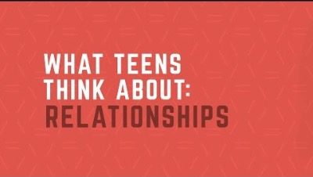
What do healthy
relationships look like?
R
Trust
Communication
Respect
Compromise
Support
R
R
R
R
© IFFOR
Notes:
What’s your relationship reality?
Embedded video: https://www.youtube.com/watch?v=DPb_B0pTBoQ
A good alternative that is a cartoon and nods to same-sex relationships: https://www.youtube.com/watch?v=UB9anEZx9LU

Slide 66




Unhealthy relationships
Pressure
Threats
Abuse
Drugs
© IFFOR
Notes:
Ask students what they think are the characteristics of unhealthy relationships, and why these can be especially damaging for young people.

Slide 67

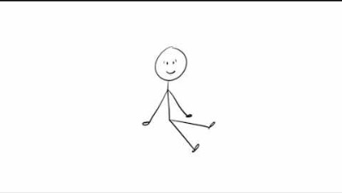
Consent
© IFFOR
Notes:
Tell students one of the most important parts of a healthy relationship is consent.
The embedded video is called “Tea and consent” and relates consent to making a cup of tea.
https://www.youtube.com/watch?v=u7Nii5w2FaI
Ask students what they learned from the video. What situations can they think of that were not covered by the video? (ex: even if you were the one offering to make tea, you can still change your mind)

Slide 68
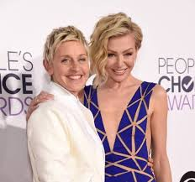
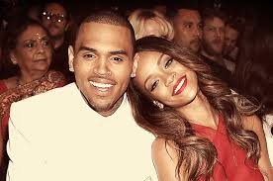
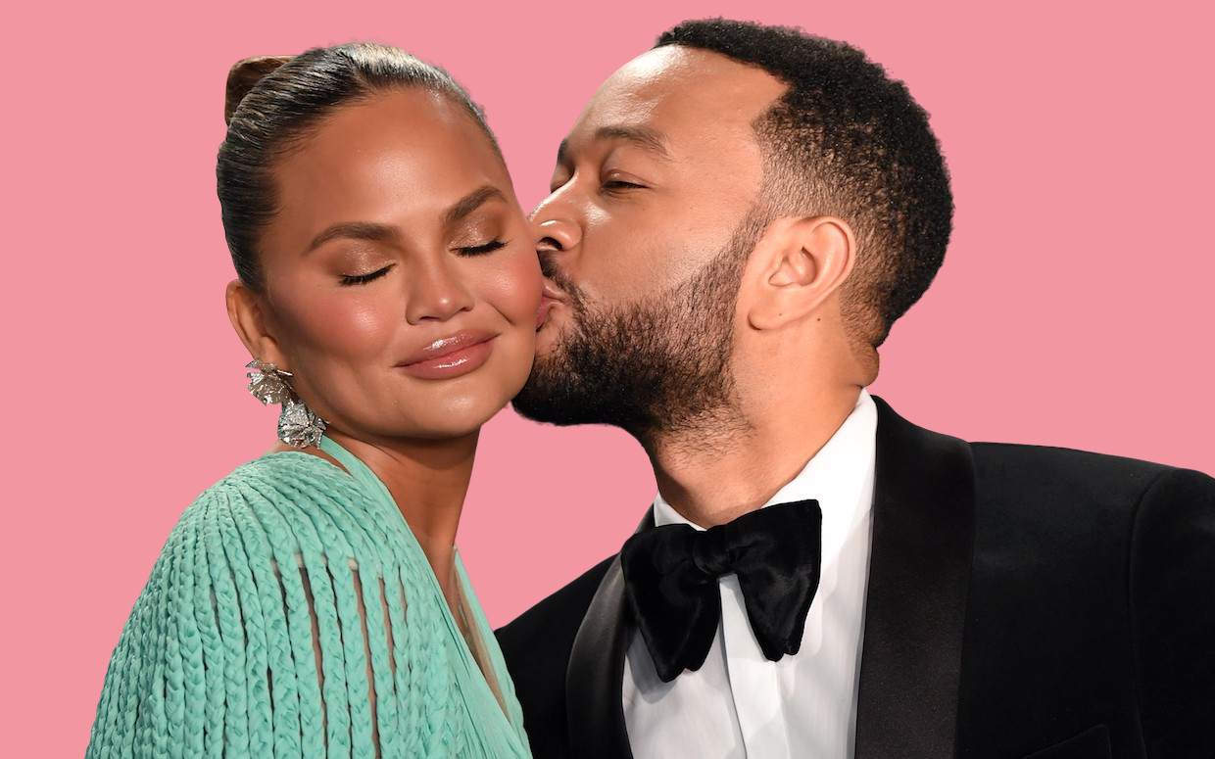
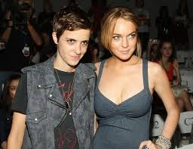
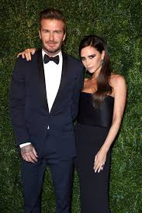
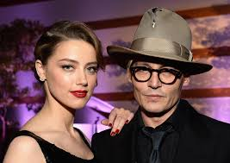
Where do you see healthy and unhealthy relationships?
© IFFOR

Slide 69

Attitudes to
sex online
8
© IFFOR
Notes:
Last lesson, we talked about unrealistic portrayals of sex in pornography, and how it can impact young people's expectations around sex. Now - let's talk about it slightly differently - how do you think pornography impacts young people's relationships?
Have students privately fill out their worksheet, then review stats from teacher’s guide. After reviewing the stats – ask students if they have any more insights on the impact of pornography on the health of young people’s relationships.

Slide 70

What we learn from
sex online
9
© IFFOR
Notes:
Have a discussion about the following: Many young people say that they learn about sex and relationships from pornography. Although we have discussed that pornography is not always realistic, let’s discuss the pros and cons of this.

Slide 71

Think about
How what people see may affect their views on relationships
The fact that pornography is rarely, if ever, true to life
Real sex and relationships are built on healthy interactions
How to give yourself a break!
© IFFOR
Notes:
Review the points on the slide, and then give students a few minutes to privately reflect and write down steps they want to take to ensure their relationships are healthy and they have realistic expectations of their own bodies.
Emphasize that the most important healthy relationship people can have is the one they have with themselves!

Slide 72
End of Part 5

Slide 73
Part 6: Protecting your image
Notes:
Prior to starting this lesson, ensure that you have established ground rules for interaction and psychological safety – and remind students that you have done this. Pupils should feel that the classroom is a safe space, that they are not expected to know anything, and are free to participate or pass on discussions.
It is important to have a baseline idea of your students exposure to this content. We recommend doing a pre-test with the following questions:
* Have you viewed sexual or sexualized content online – either accidentally or on purpose?
* Do you know what pornography is, and have you seen it?
* Are you or young people you know exploring dating and relationships?
IMPORTANT NOTE: This Powerpoint presentation was set up using the Open Sans font. You should check you have this font on the computer you will be using to show the slides or they may not appear properly. Open Sans is readily available online, and it is free to download and use. Just type "open sans font download" into a search engine and follow instructions on how to install them on your system.

Slide 74
How do people see you
online?
1
Notes:
Introduce the session and highlight that this session is about how young people portray themselves online – the images and videos they share with whom and when
Highlight that there are may ways to share images and videos online. Also emphasize that any images/content young people share with others could end up online – that includes texts, pictures, journal entries, etc.

Slide 75
Learning
outcomes
By the end of this lesson you will have:
Discussed the many ways people can share content online
Explored the implications of sharing personal photos, videos, and content
Reflected on the level of control people have over content they share
2

Slide 76
Sharing content and images
online
Look at the scenarios that you have been given.
Rate them red, amber or green.
Don’t do it
It’s fine
Maybe.
Depends
3
Notes:
Organise the class into groups of 4
Give each group a work sheet and ask them to consider the scenarios
Ask students to rank the scenarios; red; amber; or green and give reasons for their choices. They should discuss and agree these in their groups.
After completion of the task – students should be invited to give their reasons as to why they thought red; amber or green
They should consider things like:
* The long term impact of sharing images like this
* Where the image could end up
* The effect of the image being shared more widely on their future
* Whether or not the image could be deleted

Slide 77
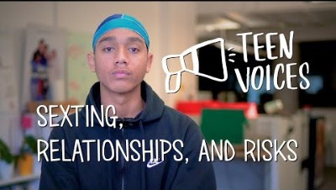
Sharing explicit pictures…
Common Sense Media
4
Notes:
Watch the video (4 mins)
https://www.youtube.com/watch?v=IZwVT6WnPQY
https://www.commonsense.org/education/videos/teen-voices-sexting-relationships-and-risks
Ask students what stood out to them from the video

Slide 78
Sharing explicit pictures…
and the law
If you share a sexually explicit image of someone - including yourself –who is under the age of 18, you are breaking the law
If you receive an image of someone that is sexually explicit and you
pass that image on you are also breaking the law
5
Notes:
Remind students that if they share explicit images – including of themselves - they are breaking the law.
Reassure them however that the law is intended to protect young people so if they behave responsibly – including reporting any incidents to an adult - there should be no reason to fear.
Every educational establishment should have a child protection policy in place to deal with incidents. It may be helpful to let students know this.

Slide 79
The
whole
picture
What is considered “pressure?”
Why are consequences different for different genders?
What are the long term implications?
6
Notes:
Divide the class into two groups. Have one group consider what kind of sexting is “experimental” – where young people are romantically/sexually involved and are voluntarily sharing pictures and content with each other.
Have the other group consider what could be considered “aggravated” – where young people feel pressured or forced to share images and content. Give each group 5 minutes to present what they discussed. Once each group has presented, hold a class discussion about the following:
* Where did they see overlap between the two categories?
* Is it possible that one person could think they were voluntarily sharing and the other party felt coerced?
* How does consent play into this?
* What are the risks to young people, regardless of consent?

Slide 80

Advice and
support
What advice would you give to a young person?
What do they need to consider when they share images?
7
Notes:
Ask students what they believe would be effective ground rules or safe guards for people their age and why. Use their suggestions to create a poster together as a class to put up in the classroom as a reminder to stay safe.

Slide 81
End of Part 6

Slide 82
Part 7: Things you can and can’t do online
Notes:
Prior to starting this lesson, ensure that you have established ground rules for interaction and psychological safety – and remind students that you have done this. Pupils should feel that the classroom is a safe space, that they are not expected to know anything, and are free to participate or pass on discussions.
It is important to have a baseline idea of your students exposure to this content. We recommend doing a pre-test with the following questions:
* Have you viewed sexual or sexualized content online – either accidentally or on purpose?
* Do you know what pornography is, and have you seen it?
* Are you or young people you know exploring dating and relationships?
IMPORTANT NOTE: This Powerpoint presentation was set up using the Open Sans font. You should check you have this font on the computer you will be using to show the slides or they may not appear properly. Open Sans is readily available online, and it is free to download and use. Just type "open sans font download" into a search engine and follow instructions on how to install them on your system.

Slide 83
Things you can,
and cannot do
online
Do you know that
the law applies to content, activities and behaviour online?
Do you know
what is considered risky online behaviour when it comes to the law?
1
Notes:
Open up the lesson with these rhetorical questions.

Slide 84
Learning
outcomes
By the end of this lesson, you will have:
Discussed the implications of accessing sexual content online
Reviewed the consequences – legally and morally - of inappropriate behavior online
Created guidelines for what young people can and cannot do online
2
Notes:
Review the learning outcomes for this lesson and take any questions as appropriate.

Slide 85
Things you can,
and cannot do
online
R
We will go through each of the questions in turn. Please mark on your worksheets what you believe are the correct answers.
T
Afterwards we will go through the answers.
3
Notes:
Set up the activity so that students are working in pairs and discussing what they think is the right answer to each question as you put up each slide. As you show each question, monitor the room to determine when most students seem to have an answer, then discuss the correct answer while students take notes in the comments sections of their worksheet.
So that students can take their notes and reflections home, ensure each student has their own worksheet.
The following slides and notes give details of the answers and discussions points

Slide 86
Things you can, and cannot do
online
Q1: You are considered to be a child in the UK until you are….
14
16
18
4
Notes:
Correct answer:
c) 18
You are considered to be a child in the UK until you are 18 years of age. The UN Convention on the Rights of the Child defines a child as everyone under 18 unless "under the law applicable to the child, majority is attained earlier".
There are a number of laws across the UK that specify different age limits in specific circumstances but broadly you are still a child up until the age of 18.

Slide 87
Things you can, and cannot do
online
Q2: Is it ok to share naked pictures or naked videos of people?
Yes, if they are over 18
Yes, if you have the consent of the
other person and they are 18 or older
Yes, if you were sent it
5
Notes:
Correct answer:
b) Yes, It is ok to share images/pictures if you have the consent of the other person and they are 18 or older
If you share naked images or videos online and the person is under 18 you are breaking the law as you are sharing an indecent image of a child, even if you are 16 and you have both consented to sharing the image/video.
If you are both over 18 and you share a naked image or video of you and your boyfriend or girlfriend, and you have each other’s permission then you are not necessarily breaking the law.
If you are both over 18 and you share the image/video online and one of the people involved has not given their consent you could be breaking the law, especially if you reveal personal information about them as well (a "revenge porn" law came into effect in 2015).

Slide 88
Things you can, and cannot do
online
Q3: Is it ok to share a naked image of yourself if you are under 18?
Yes. It’s up to you what you
share about yourself
No. You should not share
those kind of images
6
Notes:
Correct answer:
b) No. You should not share those kind of images
Even if a child has taken the picture themselves and it is considered sexually explicit it is not ok for them to share. Strictly speaking they are breaking the law as this is an indecent picture of a child.
In reality, however, unless an adult is involved or there is some degree of coercion or pressure, the police may not need to be involved at all. If the police do get involved, they still have discretion under the “outcome 21” code to take no further action, and that outcome would only be disclosed in a criminal record check if the police feel it is relevant.

Slide 89
Things you can, and cannot do
online
Q4: Is it ok to share a naked picture that has been sent to you if it is of someone under 18?
Yes, if you have been sent it
No, you are breaking the law
Yes, because you didn’t make the
image yourself
7
Notes:
Correct answer:
b) No, you are breaking the law
If a child receives a picture from a peer or another child that is sexually explicit they should not pass that image on. Distribution of the image is illegal even if it is between a couple.

Slide 90
Things you can, and cannot do
online
Q5: An “indecent image” is…
Two people having sex
A topless photo
Someone naked
8
Notes:
Correct answer:
All of the answers in the slide are correct.
It is important to stress to young people that what can be seemingly innocent pictures, e.g. romantic pictures exchanged with your girlfriend or boyfriend can be viewed as illegal if they are shared widely.
CEOP, the Child Exploitation Online Protection Centre (Part of the National Crime Agency), defines an indecent image of a child as “depicting a child engaging in sexual activity or in a sexual manner, through posing, actions, clothing etc.”
https://www.ceop.police.uk/Safety-Centre/what-is-online-child-sexual-abuse/

Slide 91
Things you can, and cannot do
online
Q6: If you see an indecent image of someone you think is a child (under 18), what should you do?
Ignore it, it will probably be taken down
Report it to the police
Report it through a reporting website
9
Notes:
Correct answer:
c) Report it through a reporting website
There are a number of online reporting services if someone comes across what they think is an indecent image of someone under 18.
Two of the best known are the Internet Watch Foundation www.iwf.org.uk and Childline’s Report Remove Tool: https://www.childline.org.uk/info-advice/bullying-abuse-safety/online-mobile-safety/remove-nude-image-shared-online/

Slide 92
Things you can, and cannot do
online
Q7: If you are under 18, is it ok to look at pornography online?
No. If you get caught by the police you
can get prosecuted
Yes, so long as I don’t lie about my age
You should consider whether it’s appropriate
for you to view the material
10
Notes:
Correct answer:
c) You should consider whether its appropriate for you to view the material
It is not against the law to watch pornography if you are under the age of 18. However, if you are a child and you are coerced into watching pornography by an adult, this would be a crime (for the adult).
Many commercial pornography sites ask people to verify their age, sometimes by requiring use of a credit card. But free pornography is readily and easily available online. Viewing indecent images of a child is illegal, whether viewing, possessing or sharing the image.
It's important for young people to be aware that pornographic content can contain much more than people just having sex and such content can be distressing.
For more information visit:
https://www.thinkuknow.co.uk/14_plus/Need-advice/Sex-and-the-law/

Slide 93
How can young people avoid
negative consequences from things they do
online?
In groups, come up with a list of online do’s and don’ts.
Use the template to build your rules for the internet.
11
Notes:
Before handing out the second worksheet, quickly debrief the quiz with the following questions:
What undesirable or negative consequences stood out to you from the quiz?
What do you think the long term implications could be to young people of being caught breaking the law?
How would you like to help keep young people safe on the internet?
Have students work in small groups to fill out the worksheet. If they have other ideas to keep young people safe on the internet, encourage them to write on the back of the sheet or on a separate paper.
Once they have all filled out their worksheets, come together as a class to create a poster to put up in the room.

Slide 94
End of Part 7

Slide 95
Part 8: Your digital world
Notes:
Prior to starting this lesson, ensure that you have established ground rules for interaction and psychological safety – and remind students that you have done this. Pupils should feel that the classroom is a safe space, that they are not expected to know anything, and are free to participate or pass on discussions.
It is important to have a baseline idea of your students exposure to this content. We recommend doing a pre-test with the following questions:
* Have you viewed sexual or sexualized content online – either accidentally or on purpose?
* Do you know what pornography is, and have you seen it?
* Are you or young people you know exploring dating and relationships?
IMPORTANT NOTE: This Powerpoint presentation was set up using the Open Sans font. You should check you have this font on the computer you will be using to show the slides or they may not appear properly. Open Sans is readily available online, and it is free to download and use. Just type "open sans font download" into a search engine and follow instructions on how to install them on your system.

Slide 96
Learning
outcomes
By the end of this lesson, you will have:
Reflected on what you’ve learned in earlier lessons
Discussed the implications of the online world for young people
Considered how the digital world
can be improved
1
Notes:
Review the learning outcomes for this final lesson.

Slide 97
Your digital
world
We have looked at:
And considered:
R What sexual content is and where it exists
R How media affects what young people think of their own bodies
R How young people feel pressured to behave
R How expectations about sex and relationships are shaped by what people see
R Online behaviours, and how to protect people from undesirable consequences
2
Notes:
* Go over what has been covered so far
• Check that they feel they have covered these areas
• Draw out any key areas that need to be considered as they develop their new and improved digital world

Slide 98
Your digital
world
During this course, we have considered how digital content makes us think and feel and its impact on our lives.
We are now going to create our own digital world and consider what we’d like to see there.
What kind of ideas have we already collected from earlier lessons?
3
Notes:
Remind students how much they have discussed and learnt in the previous seven lessons.
Highlight posters/notes you may have put up around the room and ask students to reflect on them, as well as any experiences or lessons that stood out for them during the course.
A quick reminder:
In Lesson 1: Students wrote examples of sexual content on Post-It notes and considered the difference between sexual and sexualized content in a Double-Bubble diagram. They discussed where they would find such content using notes on a “washing line”, and collectively sent a tweet about what they had learned.
Lesson 2: They looked at advertisements and stood on different sides of the room when discussing whether those images have an impact on how young people see others. They filled in a worksheet about what they think ”body image” is, and gave compliments to their classmates, telling them something positive.
3: Before and After pictures of celebrities. They wrote down one way they could help change the way media affects body image in young people.
4: Post-It notes on why some people like watching sexual material, and why some people have an issue with how sex is portrayed
5: They wrote down the characteristics of a healthy and an unhealthy relationship. They marked whether they agreed/disagreed with a series of statements about pornography, and wrote down the positive things they might learn from pornography as well as the negative impacts that pornography may have on sex and relationships.
6: A ”traffic lights” worksheet assessed risky behaviour. A poster about what to consider before sharing images, and what advice to give others on sharing.
7: A quiz about sex and the law. A list of dos and don’ts to questions about protecting themselves and others online.

Slide 99
Your digital
world
What kind of digital world would you like?
Write down two ideas
to make the digital world better
and safer for young people
4
Notes:
Have each student write down one or two ideas they have to make the digital world better and safer for young people.
Ask for a few of them to share and discuss the benefits they imagine coming from their ideas.

Slide 100
Your digital
world
Copy your ideas onto Post-it notes and stick them on the wall.
What are the common themes?
5
Notes:
Hand out Post-it notes and ask students to copy their best ideas and stick them up on the wall. Note any common themes you see emerging from the class. Ask students which ones they feel are most important or would have the greatest impact.

Slide 101

Your digital
world
Common categories used
by social media companies:
Safety
Privacy
Authenticity
Dignity
Sensitive content
Violent content
Abuse/harassment
Hate speech
False information
6
Notes:
Explain there are already rules – often called “community standards” – in place at social media companies.
The slide shows some of the most common terms used to categorise those rules: did the students come up with the same or similar themes?
Divide the class into groups and have each group think about a different topic/theme/category. If you wish you can direct them to the rules in place for those categories at different companies: links to Twitter, Facebook, YouTube and Snapchat’s standards are given below.
After a 5-10 minute discussion, have each group present their ideas back to the class, challenging and discussing as appropriate.
Twitter: https://help.twitter.com/en/rules-and-policies/twitter-rules
Facebook: https://transparency.fb.com/policies/community-standards/
YouTube: https://support.google.com/youtube/answer/9288567
Snapchat: https://www.snap.com/en-US/community-guidelines

Slide 102
Looking for more
Information?
There are some good resources online that are designed for young people and go into greater depth on the topics we have covered in this course:
ThinkUKnow: for info on digital content
Childline: if you are upset or need advice
British Library Digital Rights: design the future
Your teachers! Looking out for you
7
Notes:
Before closing out the lesson and course with the final activity, let students know there are many online resources that are designed for young people when it comes to digital content.
Included in this list are:
A site that goes into greater depth on digital content issues
An advice and guidance service
An inspiring site designed to help young people think about the issues on a bigger stage
A reminder that teachers are there to help

Slide 103

Our digital
world
The final version!
What’s in it?
Share it!
#AtFirstSite
8
Notes:
As a class, create a poster or collage bringing together all the elements of their digital world. Consider adding in elements from previous lessons to complete the picture.
Capture the end result of their digital world with a picture or in a document, without identifying the students. Consider posting the result online with the hashtag #AtFirstSite.
Ask students to identify what key lessons they are taking away from today, and their hopes for young people. Close out the course.

Slide 104
End of Part 8 and course
This product is licensed by IFFOR. Contact us at atfirstsite@iffor.org if you wish to license it.

